Slide 1

ROAD ACCIDENT ANALYSIS
Power BI Data Analytics Dashboard
Analysis of casualties, accidents, vehicle types, road conditions, light conditions and geographic distribution.
Presented by
Ayon Chakraborty
1

Slide 2

1. Project Overview
Purpose and analytical focus
• Understand road accident casualty patterns using interactive Power BI visuals.
• Track current-year (CY) casualties and accidents through KPI cards.
• Compare CY and previous-year (PY) casualty trends by month.
• Analyse casualties by vehicle type, road type, urban/rural area and light condition.
• Use road-surface and weather-condition slicers for interactive analysis.
• Use geographic mapping to examine casualty locations.
KPI Monitoring
CY casualties, accidents and casualty severity
Trend Analysis
Monthly CY vs PY comparison
Category Analysis
Vehicle, road and light-condition breakdown
Geographic View
Casualties plotted by location
2

Slide 3
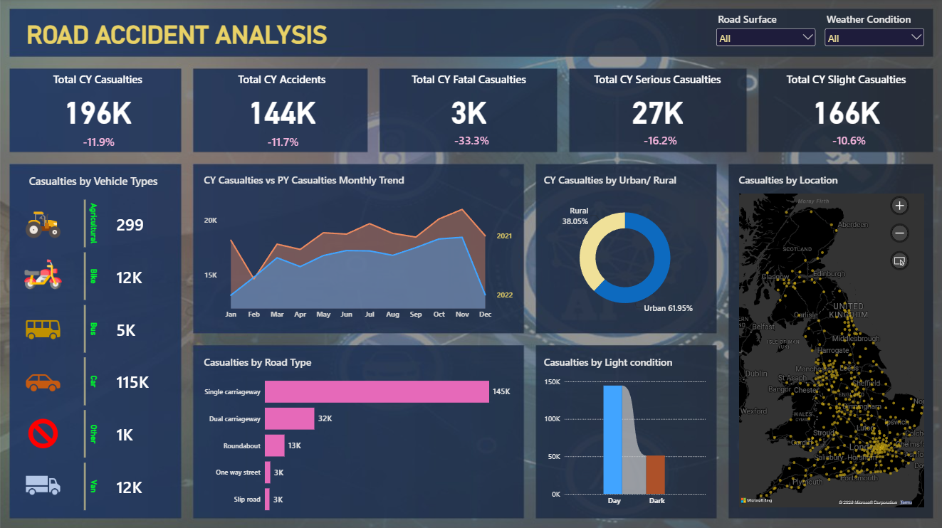
2. Interactive Power BI Dashboard
Main report page and visual layout
3

Slide 4
3. KPI Summary
Key figures visible on the dashboard
196K
Total CY Casualties
-11.9%
144K
Total CY Accidents
-11.7%
3K
Total CY Fatal Casualties
-33.3%
27K
Total CY Serious Casualties
-16.2%
166K
Total CY Slight Casualties
-10.6%
The dashboard presents current-year totals alongside percentage changes, making the headline accident and casualty measures easy to monitor.
4

Slide 5
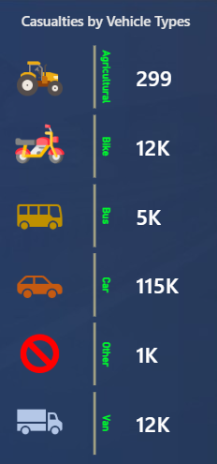
4. Casualties by Vehicle Type
Category-level breakdown shown in the dashboard
• Car is the largest vehicle category shown, at approximately 115K casualties.
• Bike and Van each contribute approximately 12K casualties.
• Bus contributes approximately 5K casualties.
• Other contributes approximately 1K casualties.
• Agricultural is shown with a much smaller value, about 299 casualties.
5

Slide 6
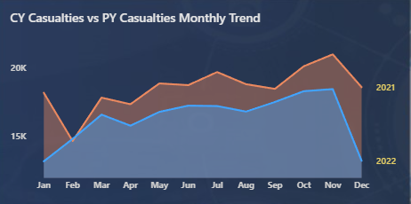
5. Monthly Trend Analysis
How casualties vary across time categories
Monthly CY vs PY trend
• CY and PY casualties are compared month by month.
• The chart shows a generally higher CY series across much of the year.
• The strongest visible CY level occurs around November before a sharp December drop.
• The comparison supports month-level performance monitoring.
6

Slide 7
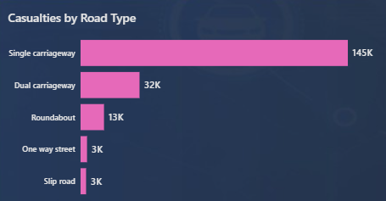
6. Road-Type Analysis
How casualties vary across road type
Casualties by road type
• Single carriageway: approximately 145K.
• Dual carriageway: approximately 32K.
• Roundabout: approximately 13K.
• One-way street: approximately 3K.
• Slip road: approximately 3K.
7

Slide 8
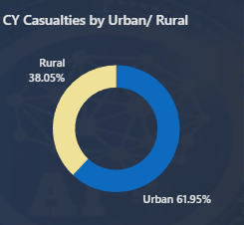
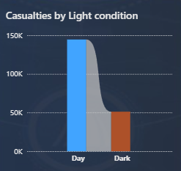
7. Conditions Analysis
Environmental and location-based views
Rural
38.05%
• Urban casualties account for about 61.95% in the dashboard's Urban/Rural donut chart.
• Rural casualties account for about 38.05%.
• The accident rate during the day is about 150k.
• And the accident rate during the night is about 50k.
• Traffic is lighter at night, so the accident rate is generally lower than during the day.
Urban
61.95%
The light-condition chart compares Day and Dark conditions.
8

Slide 9
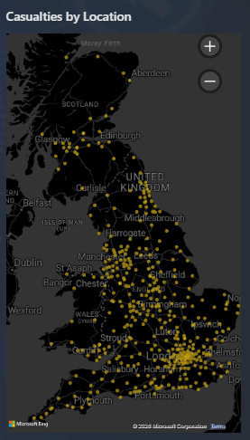
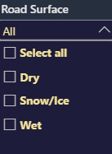
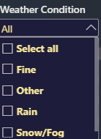
8. Location Analysis and Filtering
• The location map plots casualty points across the UK.
• Road Surface and Weather Condition slicers allow interactive filtering.
Map
UK casualty locations
Interactive slicers
Road Surface | Weather Condition
9

Slide 10
9. Key Takeaways
What the dashboard communicates
• The dashboard provides a single interactive view of accident and casualty performance.
• Current-year headline KPIs make overall casualty levels easy to monitor.
• Vehicle-type analysis highlights cars as the largest casualty category in the displayed data.
• The monthly trend provides a CY-versus-PY comparison across the year.
• Road type, light condition and urban/rural views add context to casualty patterns.
• The geographic map and slicers support location and condition-based exploration.
Dashboard Goal
Turn road-accident records into an interactive, visual analysis that supports faster understanding of casualty patterns.
Power BI • DAX • Interactive Visuals
10

Slide 11
10. Recommendations
Areas to investigate
• Analyse car-related casualties in more detail because this is the largest displayed vehicle category.
• Examine single-carriageway locations and conditions because they have the largest displayed road-type total.
• Break down urban casualties by road type, vehicle type, weather and road surface.
• Use the map to identify locations with repeated casualty records and investigate their characteristics.
Improvements
• Add drill-through pages for vehicle type, road type and location.
• Add year, month, severity and casualty-type filters for targeted comparisons.
• Track CY vs PY percentage change for each major category.
• Add richer tooltips to map and category visuals.
• Treat dashboard findings as patterns for investigation; totals and associations do not by themselves establish causation.
11

Slide 12
Thank You
12

